Slide 1

















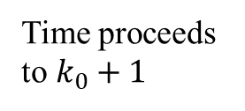















$$a[k_{0}+N−1]$$
$$a[k_{0}+N]$$
$$a[k_{0}]$$
$$a(t)$$
$$a[k_{0}+1]$$
$$a(t)$$
$$a[k_{0}+2]$$
$$s[k_{0}+N]$$
$$a[k_{0}+1]$$
$$×$$
$$×$$
Time proceeds
to $k_{0}+1$
$$s[k_{0}+1]$$
$$s[k_{0}+N+1]$$
$$s[k_{0}+1]$$
$$×$$
$$×$$
$$s[k_{0}]$$
$$s[k_{0}]$$
$$s[k_{0}+2]$$
$$s(t)$$
$$s(t)$$
$$k_{0}$$
$$k_{0}+1$$
$$. . .$$
$$k_{0}+N$$
$$k_{0}$$
$$k_{0}+1$$
$$k_{0}+2$$
$$. . .$$
$$k_{0}+N+1$$
Current time instant $k_{0}$
Current time instant $k_{0}+1$

Slide 2
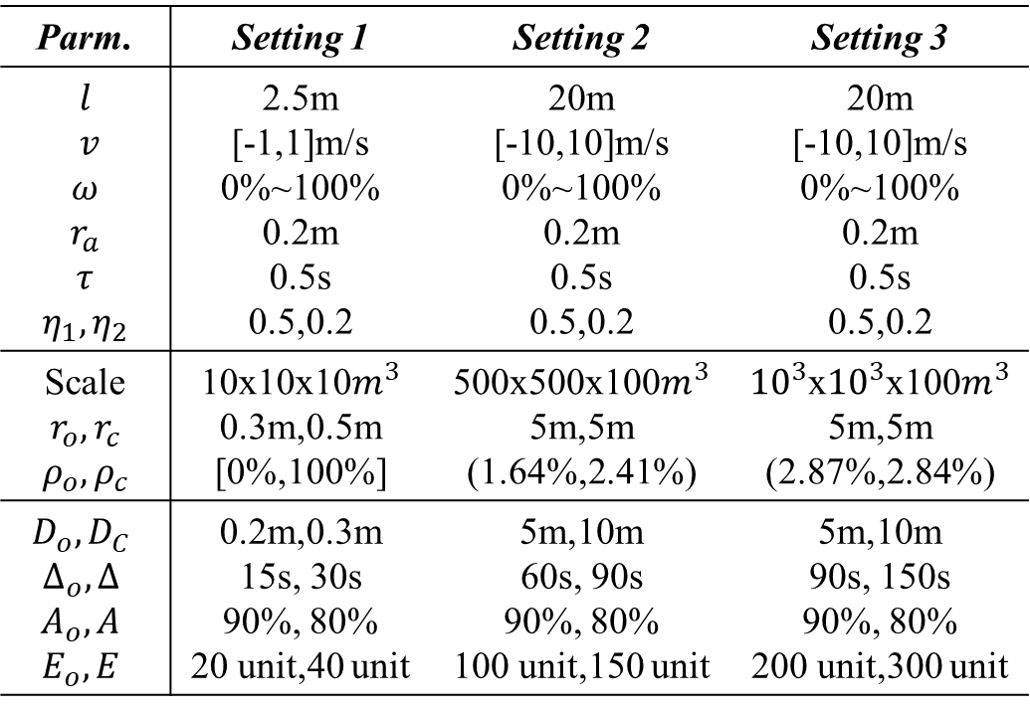
Parm. | Setting 1 | Setting 2 | Setting 3
$$l$$ $v$ $$ω$$ $$r_{a}$$ $$τ$$ $$η_{1},η_{2}$$ | 2.5m [-1,1]m/s 0%~100% 0.2m 0.5s 0.5,0.2 | 20m [-10,10]m/s 0%~100% 0.2m 0.5s 0.5,0.2 | 20m [-10,10]m/s 0%~100% 0.2m 0.5s 0.5,0.2
Scale $$r_{o},r_{c}$$ $$ρ_{o},ρ_{c}$$ | 10x10x10$m^{3}$ 0.3m,0.5m [0%,100%] | 500x500x100$m^{3}$5m,5m (1.64%,2.41%) | ${10}^{3}$x${10}^{3}$x100$m^{3}$ 5m,5m (2.87%,2.84%)
$$D_{o},D_{C}$$ $$∆_{o},∆$$ $$A_{o},A$$ $$E_{o},E$$ | 0.2m,0.3m 15s, 30s 90%, 80% 20 unit,40 unit | 5m,10m 60s, 90s 90%, 80% 100 unit,150 unit | 5m,10m 90s, 150s 90%, 80% 200 unit,300 unit

Slide 3

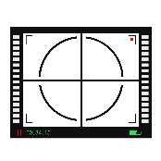
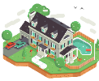








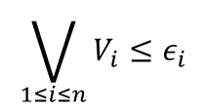








Requirement
Specifications
Requirement Satisfaction Modeling
$$DS$$
<When>
Goal Satisfaction Checking
$$𝓧(k)$$
$$δ^{∗},ε^{∗}$$
$$\bigvee_{1≤i≤n}{V_{i}≤ε_{i}}$$
Requirement Satisfaction Evaluation
Quantification Measure
calculation
$$V_{i}$$
Non-violated goal set $G_{nv}$
Violated goal set $G_{v}$
$$G_{1}$$
...
$${ G}_{j}$$
$$G_{j+1}$$
...
$${ G}_{n}$$
Observations
$Obs$
Constraints
Objective Function
$$s^{∗}$$
Motion Plan $m_{k}$
Sensor Configuration $ω_{k}$
<How>
Goal Satisfaction Optimization
$$s_{2}^{∗}$$
Actuators
Sensors
System State $s_{k}$
Environmental
Conditions
$𝒪_{k},$ $𝒞_{k}$

Slide 4






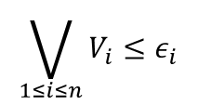



Requirements
Requirement Satisfaction Modeling
Requirement Satisfaction model $DS$
$$\bigvee_{1≤i≤n}{V_{i}≤ε_{i}}$$
Requirement Satisfaction Evaluation
$$𝓧(k)$$
Quantification Measure
calculation
$$V_{i}≤ε_{i}$$
$$V_{i}>ε_{i}$$
Satisfied Requirement set $R_{s}$
Unsatisfied Requirement set $R_{ns}$
$$R_{1}$$
...
$${ R}_{j}$$
$$R_{j+1}$$
...
$${ R}_{n}$$
Observations
$Obs$
Constraints
Objective Function
$$s^{∗}$$
Motion Plan $m_{k}$
Sensor Configuration $ω_{k}$
<How>
Goal Satisfaction Optimization
$$s_{2}^{∗}$$
Actuators
Sensors
System State $s_{k}$
Environmental
Conditions
$𝒪_{k},$ $𝒞_{k}$

Slide 5

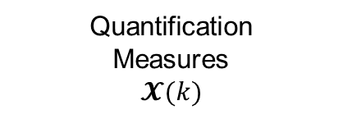





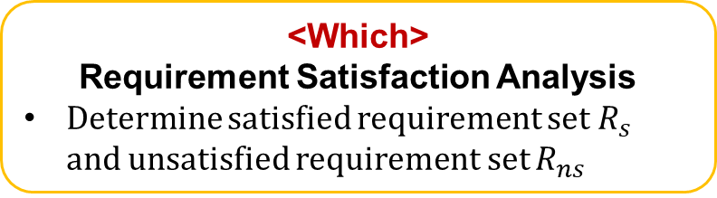



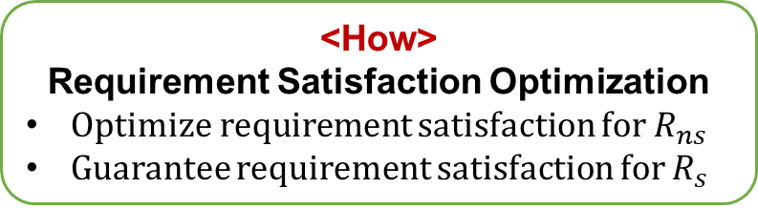
<Which>
Requirement Satisfaction Analysis
Determine satisfied requirement set $R_{s}$ and unsatisfied requirement set $R_{ns}$
Resolution $s^{∗}$
$$R_{ns}≠∅$$
<When>
Requirement Satisfaction Checking
Construct slacked requirement constraints
Minimize the slack variables
<How>
Requirement Satisfaction Optimization
Optimize requirement satisfaction for $R_{ns}$
Guarantee requirement satisfaction for $R_{s}$
Quantification
Measures
$$𝓧(k)$$
Updated resolution
$s^{∗}←s_{2}^{∗}$
$$R_{ns}=∅$$
$$s^{∗}$$
Sensors
Actuators
Environmental Conditions $𝒪_{k},$ $𝒞_{k}$
Motion Plan $m_{k}$
System State $s_{k}$
Sensor Configuration $ω_{k}$

Slide 6
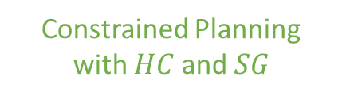
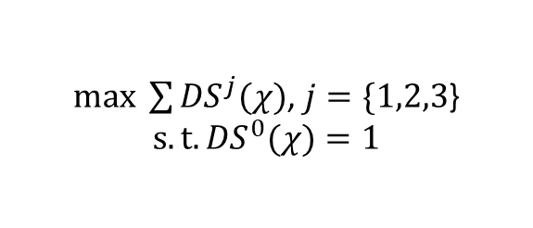

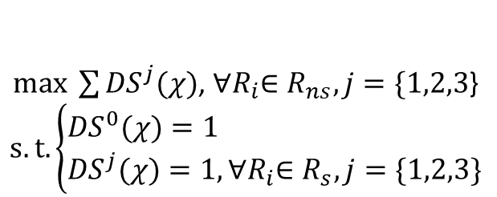
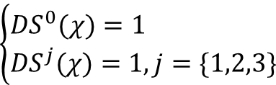
Constrained Planning with $HC$ and $SG$
Layer 1
$$\left\{\begin{aligned}&{DS}^{0}(χ)=1 \\ &{DS}^{j}(χ)=1, j=\{1,2,3\}\end{aligned}\right.$$
Captain
flexibility
Layer 2
$max \sum{{DS}^{j}(χ)}$, ${∀R}_{i}∈R_{ns}, j=\{1,2,3$}
$$s.t. \left\{\begin{aligned}&{DS}^{0}(χ)=1 \\ &{DS}^{j}(χ)=1,{∀R}_{i}∈R_{s}, j=\{1,2,3\}\end{aligned}\right.$$
satisfaction
Layer 3
Optimal Planning with $HC$
$max \sum{{DS}^{j}(χ)}$, $j=\{1,2,3$}
$$s.t. {DS}^{0}(χ)=1$$

Slide 7




Autonomous Controller
Requirements-Driven Adaptation
Analyzing
Requirement
Satisfaction
Measuring
Requirement
Satisfaction Evaluating
Requirement
Satisfaction Optimizing
Analyzing
Autonomous Unmanned System
Planning
Feed-forward
Feedback
Controlled System
Monitoring
Executing
Interaction
Input
Output
...
Humans
Obstacles
Private
Regions
Environment

Slide 8
Autonomous Controller
Requirements-Driven Adaptation
Requirement
Satisfaction
Measuring
Environment
Situation
Analyzing
Requirement
Satisfaction Evaluating
System
Behavior
Analyzing
Requirement
Satisfaction Optimizing
Autonomous Unmanned System
Planning
Feed-forward
Feedback
Monitoring
Controlled System
Executing
Interaction
Input
Output
...
Humans
Obstacles
Private
Regions
Environment

Slide 9
Autonomous Unmanned System
Autonomous Controller
Environment
Analyzing
System
Analyzing
Autonomous Planning
Requirements
Satisfaction
Checking
Requirements
Satisfaction Analyzing
Requirements
Satisfaction Optimizing
Environment
Monitoring
Feed-forward
Deploying
Feedback
System
Monitoring
Controlled System
Sensing
Interaction
Executing
...
Humans
Obstacles
Private
Regions
Environment

Slide 10
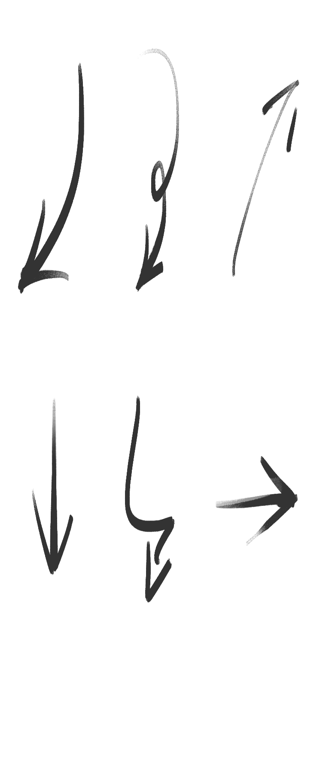
Autonomous Unmanned System
Autonomous Controller
Knowledge Repository
Environment
Situation
Analyzing
System
Behavior
Analyzing
Environment Model
System Model
Autonomous Planning
Requirement
Satisfaction Evaluating
Requirement
Satisfaction Optimizing
Requirement Model
Environment
Monitoring
Feed-forward
Deploying
Feedback
System
Monitoring
Controlled System
Sensing
Interaction
Executing
Input
Output
...
Humans
Obstacles
Private
Regions
Environment

Slide 11
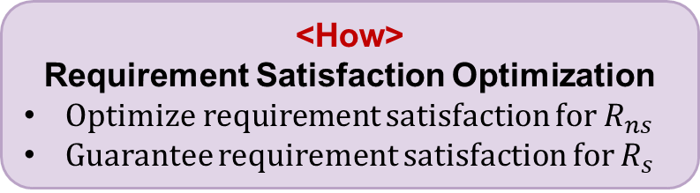


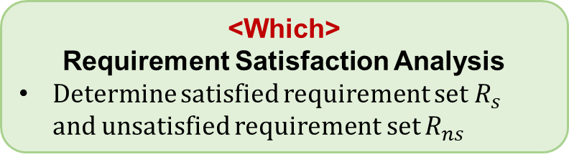
<Which>
Requirement Satisfaction Analysis
Determine satisfied requirement set $R_{s}$ and unsatisfied requirement set $R_{ns}$
Resolution $s^{∗}$
$$R_{ns}≠∅$$
<When>
Requirement Satisfaction Checking
Construct slacked requirement constraints
Minimize the slack variables
<How>
Requirement Satisfaction Optimization
Optimize requirement satisfaction for $R_{ns}$
Guarantee requirement satisfaction for $R_{s}$
Quantification
Measures
$$𝓧(k)$$
Updated resolution
$s^{∗}←s_{2}^{∗}$
$$R_{ns}=∅$$
Resolution $s^{∗}$
Sensors
Actuators
Environmental Conditions $𝒪_{k},$ $𝒞_{k}$
Motion Plan $m_{k}$
System State $s_{k}$
Sensor Configuration $ω_{k}$

Slide 12
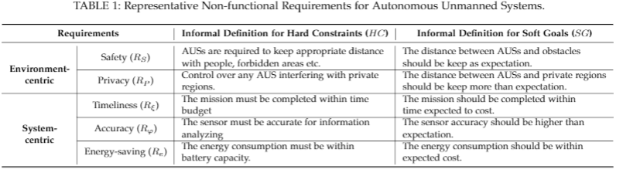

Slide 13
Autonomous Unmanned System
Autonomous Controller
Environment
Situation
Analyzing
System
Behavior
Analyzing
Requirements-Driven Adaptation
Requirement
Satisfaction
Measuring
Requirement
Satisfaction Evaluating
Requirement
Satisfaction Optimizing
Environment
Monitoring
Feed-forward
Deploying
Feedback
System
Monitoring
Controlled System
Sensing
Interaction
Executing
Input
Output
...
Humans
Obstacles
Private
Regions
Environment

Slide 14
















































$$M_{1}(𝒳)$$
$$M_{2}(𝒳)$$
$$M_{3}(𝒳)$$
$$1$$
$$1$$
$$1$$
$$0$$
$$g$$
$$𝒳$$
$$0$$
$$g$$
$$𝒳$$
$$0$$
$$𝒳$$
$$g$$
$${DS}^{1}(𝒳_{i})$$
$${DS}^{2}(𝒳_{i})$$
$${DS}^{3}(𝒳_{i})$$
$$1$$
$$1$$
$$1$$
$$δ_{i}$$
$$ε_{i}$$
$$ε_{i}$$
$$δ_{i}$$
$$0$$
$$\{$$
$$𝒳_{i}$$
$$0$$
$$\{$$
$$𝒳_{i}$$
$$0$$
$$\{$$
$$\{$$
$$𝒳_{i}$$
$${lb}_{i}$$
$$g_{i}$$
$${ub}_{i}$$
$${lb}_{i}$$
$$g_{i}$$
$${ub}_{i}$$
$${lb}_{i}$$
$$g_{i,1}$$
$$g_{i,2}$$
$${ub}_{i}$$
$$(1)$$
$$(2)$$
$$(3)$$

